Slide 1
Weather monitoring
Saurabh Marne (1001874597)
Mehek Thaker (1001869277)

Slide 2
What is the application?
It monitors the weather parameters like temperature, pressure, humidity and brightness.
Uses lightweight protocol to send and receive sensor data.
It gives the owner flexibility to visualize data.
It also sends alert messages to the owner in case of some anomaly. So that the actions can be taken accordingly.

Slide 3
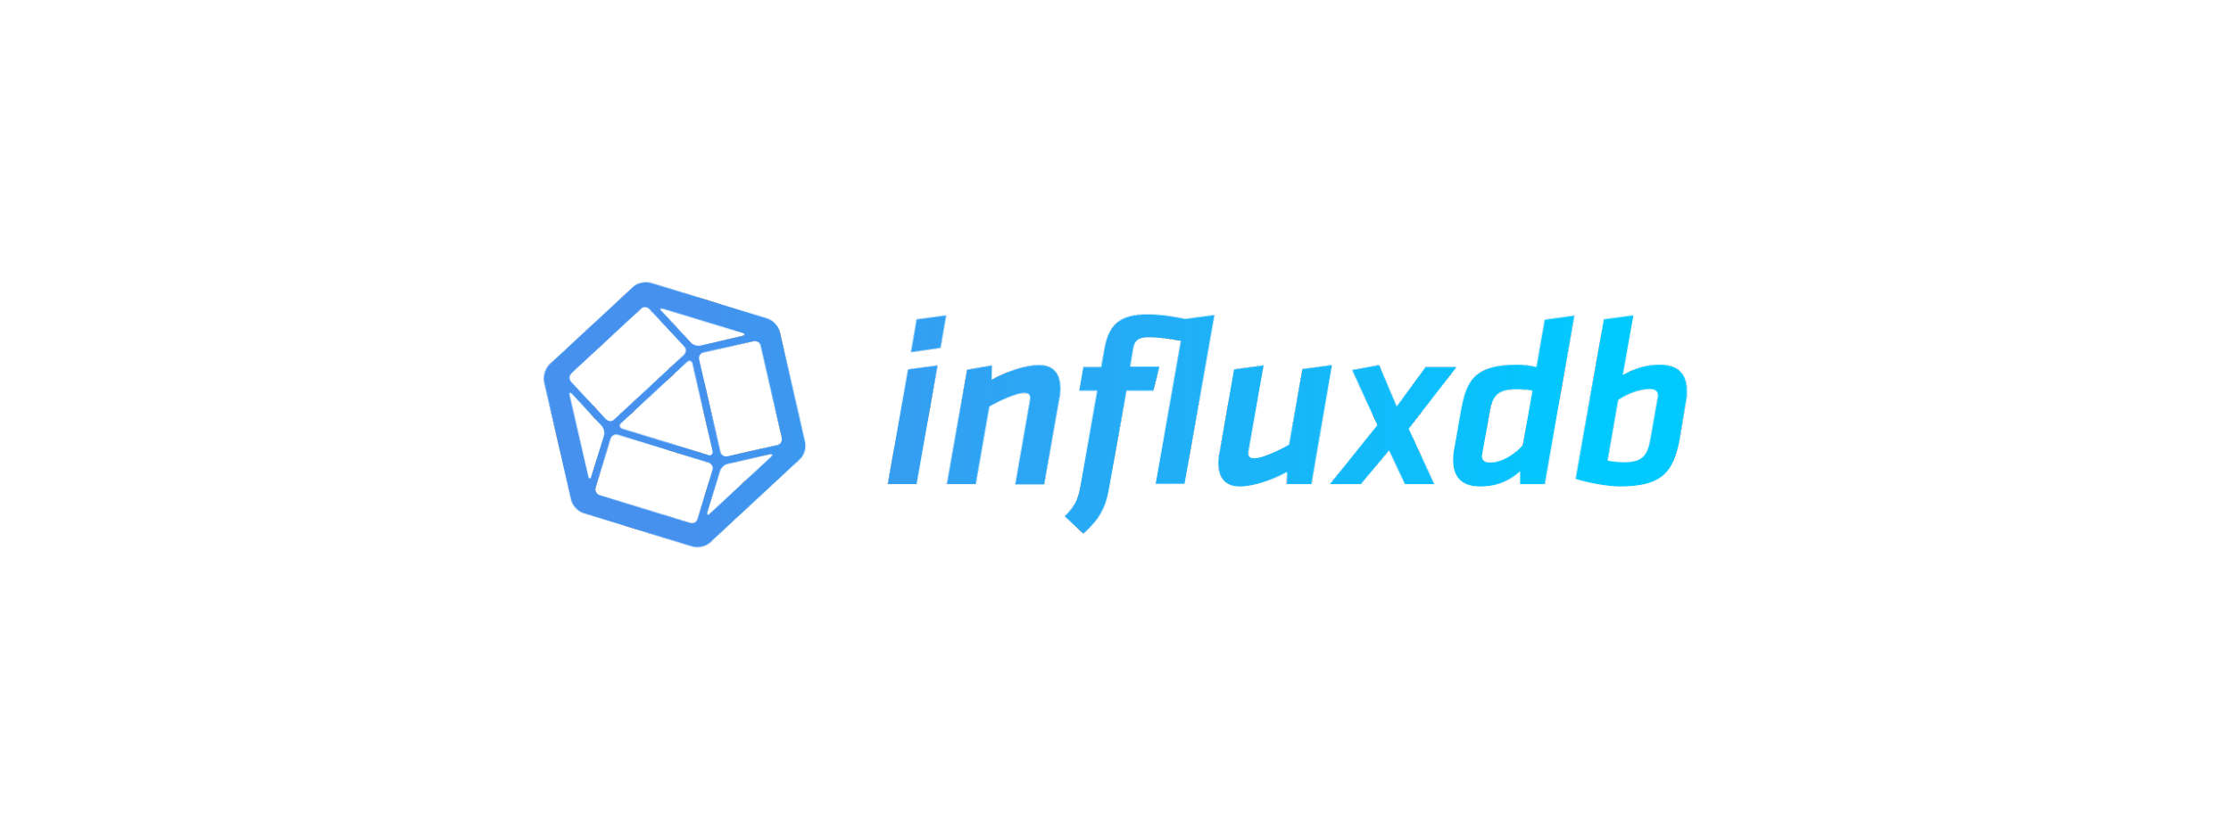







Technologies/Components used

Slide 4
Why use these technologies?
Our application requirements were very specific so we wanted to use time-series database such as influxDb to store the weather readings.
To generate trends we have used grafana as it is compatible with the influxDb.
As it has a simple and light backend service we have used flask for backend and angular for the front end.

Slide 5
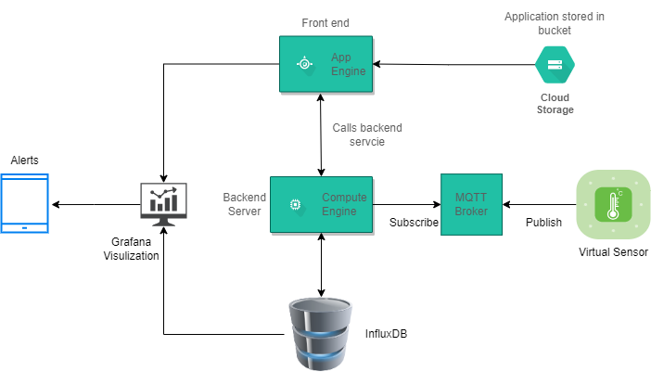

Slide 6
Demo

Slide 7
Future Scope
Can use Raspberry pi, sensors to get the actual readings instead of simulated ones.
Can you use actuators to control the environment remotely.

Slide 8
THANK YOU

Slide 9
Questions????

